Slide 1
Reinforcement learning for retrosynthesis with chemoenzymatic reactions and type I polyketide synthases

Slide 2
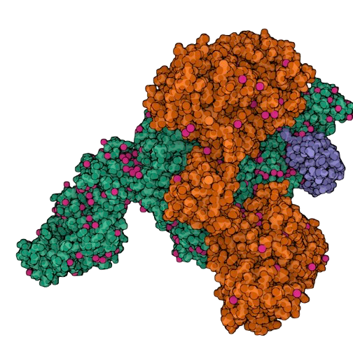





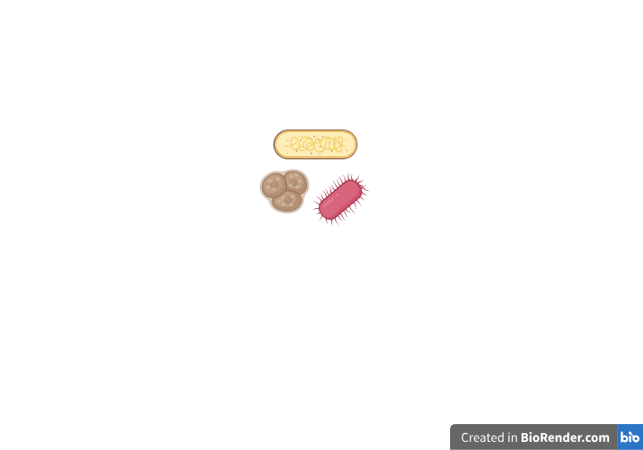


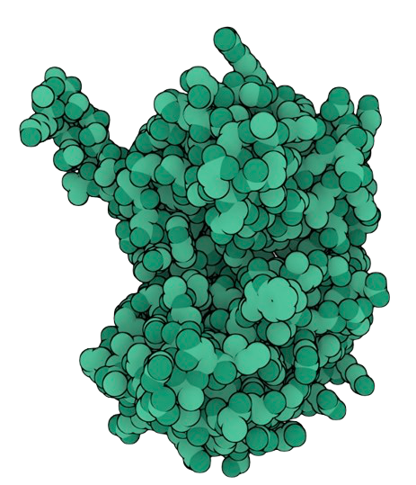
For insoluble and/or cytotoxic targets
Multifunctional enzymes
(“molecular lego”)
~2000 kDa
Chemical catalysis
Saccharomyces cerevisiae
For elongated carbon backbones
x
Escherichia coli
Monofunctional
enzymes
For stereoselective & regioselective modifications
KS
AT
ACP
KS
AT
KR
ACP
NAD(+)
Loading
Module
Ext.
Module
NADH
Alcohol Dehydrogenase (EC 1.1.1.143)
Malonyl-CoA
( extension )
Hydroxymalonyl-CoA
( loading )
30 - 40 kDa
Figure 1. TridentSynthRL leverages the complementary strengths of synthetic chemistry as well as mono- and multi-functional enzymes to access a wide chemical space of molecular targets. Monofunctional enzymes, which catalyze a single reaction, excel at regioselectively and stereoselectively performing small modifications on a substrate’s carbon backbone. Meanwhile, multifunctional enzymes, which catalyze multiple reactions, can construct such carbon backbones through the iterative catalysis of acyl-CoA substrates, as in the case of polyketide synthases (PKSs). Despite their ability to catalyze reactions in a controlled and selective manner, enzymes cannot function under temperatures and pressures outside of typical physiological conditions, nor can their host cells survive cytotoxic intermediates, such as aldehydes or long-chain alcohols. Consequently, the suite of functional group transformations biology can catalyze is relatively narrow, thereby providing an opportunity to couple both forms of enzymatic chemistry with synthetic chemistry to ultimately synthesize more targets than would be possible with either route alone.

Slide 3
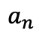
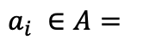
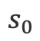
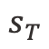
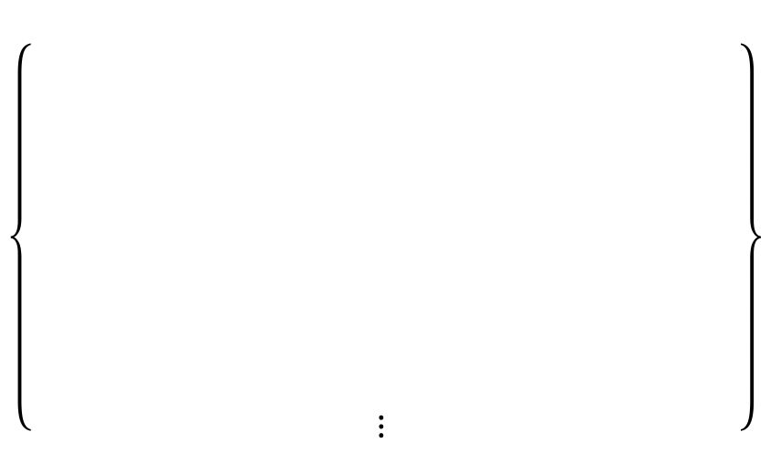
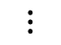


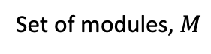
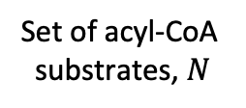
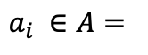

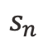
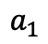
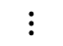
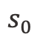
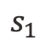


Chemoenzymatic agent
$$\left\{\begin{aligned} \\ \\ \\ \\ \\ \\ \\ \\ \\ \\ ⋮ \end{aligned}\right\}$$
386 chemical + 3604 enzymatic templates (n=3990)
Target: 7,8-dihydrokavain
HCl
+
Esterification of acid halides
$$s_{0}$$
Step 1: chemoenzymatic expansion
$$a_{i} ∈A=$$
Chemical template: R(C=O)Cl . R’(OH) >> R-C(=O)O-R’
$$a_{1}$$
$$…$$
$$a_{n}$$
CO₂
Decarboxylase EC 4.1.1.x
$$s_{1}$$
$$s_{n}$$
Enzymatic template: RCOOH >> R . O=C=O
$$…$$
$$…$$
$$s_{T}$$
Collect and update rewards
Chemical building block:
3-phenylpropan-1-ol
Rollouts can launch
another MCTS agent
PKS agent
DH
Chemical building block
$$s_{0}$$
KR
Chemical reaction
KS
ACP
AT
$$a_{i} ∈A=$$
KS
ACP
x
Enzymatic reaction
Biological building block
AT
PKS reaction
KR
KS
ACP
AT
Polyketide (predicted/ known)
$$⋮$$
$$⋮$$
KS
AT
PKS domains
Set of modules, $M$
Set of acyl-CoA substrates, $N$
DH
General compound node
Notes:
Use a toy example to show that depth won

Slide 4
1. Selection
2. Chemoenzymatic Expansion
3. Update
Chemoenzymatic agent
Chemoenzymatic agent
Chemoenzymatic agent
Target
Target
Target
Selected node
Expand
Launch PKS MCTS agent upon encountering polyketides
Chemical building block:
3-phenylpropan-1-ol
Backpropagate rewards up to
root node
PKS agent
Figure 2. Overview of the TridentSynthRL multi-agent Monte Carlo tree search (MCTS) framework for retrosynthetic planning. The algorithm proceeds through three iterative phases. (1) Selection: The chemoenzymatic agent traverses the search tree from the target molecule, selecting a leaf node (red circle) for expansion based on learned value estimates. (2) Chemoenzymatic Expansion: The selected node is expanded by applying chemical (blue arrows) and enzymatic (green arrows) retrosynthetic transformations to generate precursor nodes. Expansion terminates when all precursors resolve to commercially available building blocks (blue squares), biological building blocks (green squares), or known polyketide intermediates (orange squares), yielding a terminal state S_T. When a predicted or known polyketide intermediate is encountered during expansion, a specialized PKS agent is launched to explore polyketide synthase assembly line configurations (orange arrows) for that substructure. (3) Update: Upon reaching a terminal state, rewards are backpropagated (red dashed arrows) from the terminal node up to the root, updating value estimates along the traversed path to guide future iterations toward higher-quality retrosynthetic routes.

Slide 5
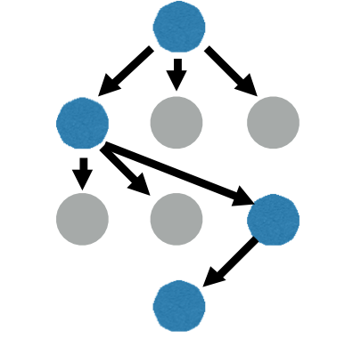






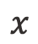
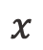


Step 1: generate polyketides
Step 2: modify polyketides
Extension Module 1
Extension Module 2
Extension Module 3
DORAnet
KS
AT
ACP
KS
AT
ACP
KS
AT
ACP
RetroTide
Termination domain
Loading Module
KR
KR
KR
~1M chemical products (labelled 0)
KS
AT
ACP
KS
AT
ACP
KS
AT
ACP
TE
KS
AT
ACP
$$x$$
$$x$$
$$x$$
Chemical modifications
DH
KR
DH
KR
DH
KR
KS
AT
ACP
KS
AT
ACP
KS
AT
ACP
29 starter units per module
DH
KR
ER
DH
KR
ER
DH
KR
ER
KS
AT
ACP
KS
AT
ACP
KS
AT
ACP
6 extender units per module
Enzymatic modifications
~1M enzymatic products (labelled 0)
$$⋮$$
~1M polyketide molecules
(labelled 1)
$$⋮$$
$$⋮$$
$$⋮$$
Figure 3. Polyketide libraries and their chemoenzymatically-modified counterparts were synthetically generated to build a training set for a supervised polyketide classification model. Our previously released PKS design tool, RetroTide, was used to build an initial database of polyketide scaffolds by combinatorially assembling chimeric type I PKS designs in silico with 1) a single loading module, 2) up to 3 extension modules (each with all possible domain architectures, i.e., KS, AT, ACP, and optional KR, DH, and ER domains), and a 3) terminal thioesterase domain allowing for both thiolysis and lactonization offloading reactions, yielding approximately 1 million core polyketide structures (labelled 1) for training. These structures were then modified further via DORAnet for a single step using all synthetic chemistry and enzymatic chemistry reaction templates. For each polyketide, the most chemically similar product from the synthetic chemistry modified set as well as that from the from the enzymatic chemistry modified set was selected, yielding approximately 2 million polyketide variants (labelled 0) to be added to the training set.

Slide 6



Molecular graph construction
Graph attention backbone
Readout and pooling
Node features
C1
Linear Projection
Multi-head projection
C2
C3
Attention
C4
$$⋮$$
$$⋮$$
Mean pooling
6
Transformed node features
LayerNorm
1
5
2
4
ELU
Node embedding
3
Graph embedding
Edge features
dropout
“O=C1C=C(O)C=CO1”
C1=C2
SMILES input
C2-C3
C3=C4
$$⋮$$
$$⋮$$
Polyketide synthesizability score = 0.76
Classification Head
Figure 4. Architecture of supervised GNN. Input SMILES strings are parsed with RDKit into molecular graphs in which atoms are represented as nodes and bonds as edges. Each atom is encoded as a 40-dimensional one-hot feature vector capturing atomic number, degree, formal charge, hydrogen count, hybridization, aromaticity, and ring membership, while each bond is encoded as a 5-dimensional one-hot vector indicating bond type or self-loop. Node features are projected into a 256-dimensional hidden space via a learned linear transformation, and edge features are incorporated directly at the attention computation step. The backbone consists of 3 stacked graph attention layers, each with 4 multi-head attention heads, residual connections, LayerNorm, ELU activation, and dropout (p = 0.1). After the final attention layer, node embeddings are mean-pooled to produce a single graph-level representation, which is passed through a two-layer classification head with sigmoid activation to yield the predicted probability of the input molecule being a polyketide synthase (PKS) product.

Slide 7
Kavain
5,6-dihydroyangonin
7,8-dihydroyangonin
5,6-dehydromethysticin
Yangonin
5,6,7,8-tetrahydroyangonin
7,8-dihydroyangonin
Methysticin
10-methoxyyangonin
Desmethoxyyangonin
5-hydroxykavain
11-methoxyyangonin
11-methoxy-12-hydroxyyangonin
7,8-dihydrokavain
Figure 5. Chemical structures of the kavalactone family from Piper methysticum (kava) for which TridentSynthRL was tested against. The six major kavalactones, i.e., kavain, 7,8-dihydrokavain, yangonin, Desmethoxyyangonin, Methysticin, and 7,8-dihydromethysticin are shown, along with their related structural analogs. These compounds share a core $α$-pyrone scaffold and vary in their aromatic substitutions, degrees of saturation, and hydroxylation/ methoxylation patterns, all of which contribute to their various pharmacological effects, including their anxiolytic, analgesic, and neuroprotective properties. TridentSynthRL was able to find thermodynamically feasible pathways to all members of the kavalactone family with at least one pathway for each structure involving a type I PKS. Users also have the option to tune the total number of pathways enumerated by running TridentSynthRL for fewer or more iterations.

Slide 8
7,8-dihydrokavain
SAH
DORA-XGB score = 0.955
SAM
LM
M1
M2
M3
PKS offloading
H₂O
DH
KR
ER
KR
KR
KS
AT
ACP
KS
AT
ACP
KS
AT
ACP
KS
AT
ACP
TE
ΔH = -6.27 kcal/mol
Starter unit: benzoyl-CoA
Dehydration of alcohols
Chemical reaction
Chemical building block
Extender unit: malonyl-CoA
Enzymatic reaction
Biological building block
PKS reaction
Extender unit: malonyl-CoA
Polyketide (predicted/ known)
KS
Extender unit: malonyl-CoA
AT
PKS domains
DH
General compound node
Figure 6. TridentSynthRL successfully proposes a pathway to the kavalactone 7,8-dihydrokavain via type I PKSs, monofunctional enzymes, and synthetic organic chemistry. In the select pathway shown, a chimeric PKS with a benzoyl-CoA starter unit is suggested, along with 3 extension modules, each of which incorporate malonyl-CoA as extender units and module-specific tailoring domains (DH, KR, ER). Following a thioesterase (TE)-mediated lactonization offloading reaction, the core $α$-pyrone scaffold for 7,8-dihydrokavain is produced. With this scaffold, an enthalpically downhill (-6.27 kcal/mol) dehydration reaction is subsequently suggested, followed by an enzymatic O-methylation reaction. This O-methylation reaction is predicted to be enzymatically feasible with a feasibility score of 0.955, as assigned by our previously released supervised reaction feasibility classifier, DORA-XGB.

Slide 9
CO₂
H₂O
DORA-XGB score = 0.995
DORA-XGB score = 0.964
SAH
SAM
DORA-XGB score = 0.977
Desmethoxyyangonin
H₂O
Electrophilic aromatic alkylation with alcohols
ΔH = -11.38 kcal/mol
LM
M1
KR
PKS offloading
KS
AT
ACP
KS
AT
ACP
TE
Chemical building block
Chemical reaction
Starter unit: benzoyl-CoA
4-hydroxy-2H-pyran-2-one
Enzymatic reaction
Biological building block
PKS reaction
KS
Polyketide (predicted/ known)
AT
PKS domains
Extender unit: hydroxymalonyl-CoA
DH
General compound node
Figure 7. TridentSynthRL successfully proposes a pathway to the kavalactone desmethoxyyangonin via type I PKSs, monofunctional enzymes, and synthetic organic chemistry. Here, TridentSynthRL uses a simple one extension module-long PKS with a benzoyl-CoA starter unit and a hydroxymalonyl-CoA extender unit to build a polyketide fragment that accounts for the final aromatic moiety present in desmethoxyyangonin. TridentSynthRL then suggests coupling this polyketide fragment with the commercial chemical building block 4-hydroxy-2H-pyran-2-one to also account for the six-membered lactone ring present in desmethoxyyangonin. An enthalpically downhill (-11.38 kcal/mol) electrophilic alkylation reaction is suggested for this coupling, after which the resulting backbone enzymatically undergoes an O-methylation, decarboxylation, and a dehydration reaction to finally produce desmethoxyyangonin. These enzymatic reactions are all predicted to be feasible by DORA-XGB.

Slide 10
Intramolecular addition of alcohols or acids to alkenes
HBr
Dehydrohalogenation
Hydration of alkenes, addition of alcohols or acids
to alkenes
5,6,7,8-tetrahydroyangonin
Addition of hydrogen halides to alkynes
methanol
HBr
Suzuki coupling with alkynes
Chemical reaction
Chemical building block
Enzymatic reaction
Biological building block
PKS reaction
KS
Polyketide (predicted/ known)
AT
PKS domains
1-(but-3-yn-1-yl)-4-methoxybenzene
3-bromoprop-2-ynoic acid
DH
General compound node
Figure 8: Purely chemical retrosynthetic route to 5,6,7,8-tetrahydroyangonin proposed by TridentSynthRL. Starting from two commercially available building blocks — 1-(but-3-yn-1-yl)-4-methoxybenzene and 3-bromoprop-2-ynoic acid — a Suzuki coupling with alkynes forms a methoxyphenyl-substituted bromoacrylic acid intermediate. Subsequent addition of HBr to the alkyne moiety yields a vinyl bromide bearing the full carbon skeleton. Intermolecular esterification with methanol, a third chemical building block, followed by intramolecular addition of the alcohol to the pendant alkene generates the six-membered lactone ring. A final dehydrohalogenation eliminates HBr to furnish 5,6,7,8-tetrahydroyangonin.

Slide 11
Cryptofolione
Ring-opening Metathesis
ΔH = -1.40 kcal/mol
LM
M1
KR
M2
KR
PKS offloading
KS
AT
ACP
KS
AT
ACP
KS
AT
ACP
TE
NAD(+)
DORA-XGB score = 0.931
H₂O
NADH
O₂
Starter unit: cinnamoyl-CoA
Extender unit: malonyl-CoA
Cyclohex-3-en-1-ol
Extender unit: malonyl-CoA
Chemical building block
Chemical reaction
Enzymatic reaction
Biological building block
PKS reaction
KS
Polyketide (predicted/ known)
AT
PKS domains
DH
General compound node
Figure 9: TridentSynthRL successfully proposes a shorter pathway to cryptofolione via type I PKSs, monofunctional enzymes, and synthetic organic chemistry. In our previous work, a single chimeric PKS assembly spanning five extension modules was proposed to construct the full cryptofolione scaffold. Here, TridentSynthRL identifies a more efficient pathway design involving a chimeric PKS spanning only two extension modules to produce a fragment that captures the aromatic styryl moiety and 6-membered lactone ring of cryptofolione. This fragment is then coupled via an enthalpically downhill (-1.40 kcal/mol) ring opening metathesis reaction with cyclohex-3-ene-1,4-diol. Cyclohex-3-ene-1,4-diol was in turn obtained from an enzymatic monooxygenation reaction with cyclohex-3-ene-1-ol, which is a commercially available chemical building block. DORA-XGB predicts this monooxygenation reaction to be feasible with a score of 0.931.

